Slide 1
An introduction to
Deep Learning

Slide 2
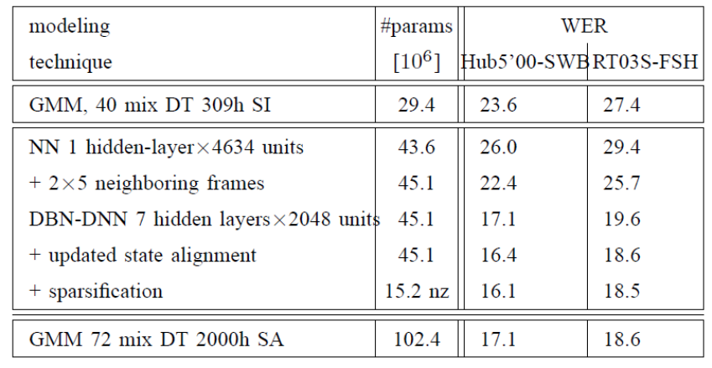
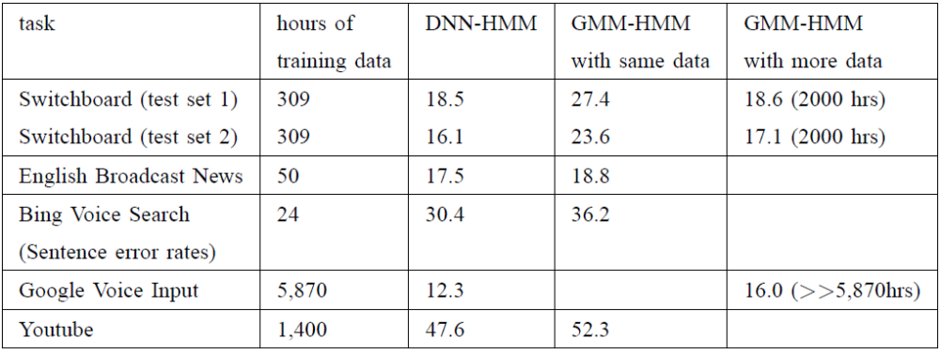
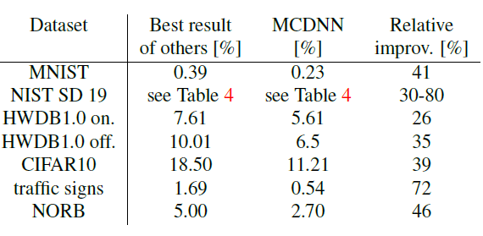
DL is providing breakthrough results in speech recognition and image classification …
From this Hinton et al 2012 paper:
http://static.googleusercontent.com/media/research.google.com/en//pubs/archive/38131.pdf
go here: http://yann.lecun.com/exdb/mnist/
From here:
http://people.idsia.ch/~juergen/cvpr2012.pdf

Slide 3
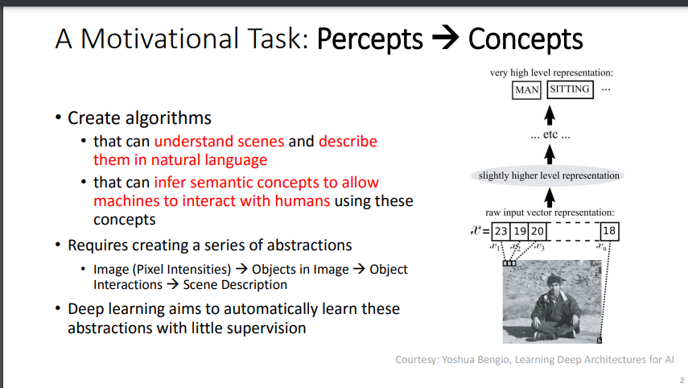
David Corne, and Nick Taylor, Heriot-Watt University - dwcorne@gmail.com
These slides and related resources: http://www.macs.hw.ac.uk/~dwcorne/Teaching/dmml.html

Slide 4

David Corne, and Nick Taylor, Heriot-Watt University - dwcorne@gmail.com
These slides and related resources: http://www.macs.hw.ac.uk/~dwcorne/Teaching/dmml.html

Slide 5
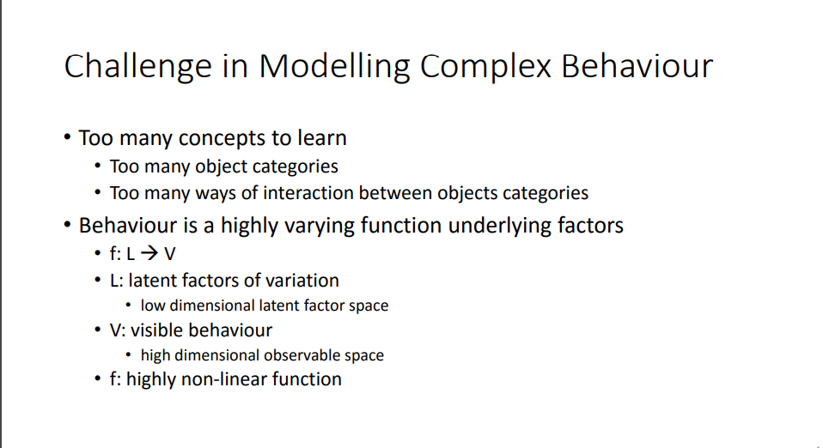
David Corne, and Nick Taylor, Heriot-Watt University - dwcorne@gmail.com
These slides and related resources: http://www.macs.hw.ac.uk/~dwcorne/Teaching/dmml.html

Slide 6
So, 1. what exactly is deep learning ?
And, 2. why is it generally better than other methods on image, speech and certain other types of data?

Slide 7
So, 1. what exactly is deep learning ?
And, 2. why is it generally better than other methods on image, speech and certain other types of data?
The short answers
1. ‘Deep Learning’ means using a neural network
with several layers of nodes between input and output
2. the series of layers between input & output do
feature identification and processing in a series of stages,
just as our brains seem to.

Slide 8
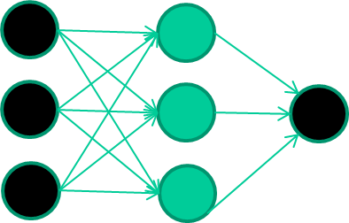
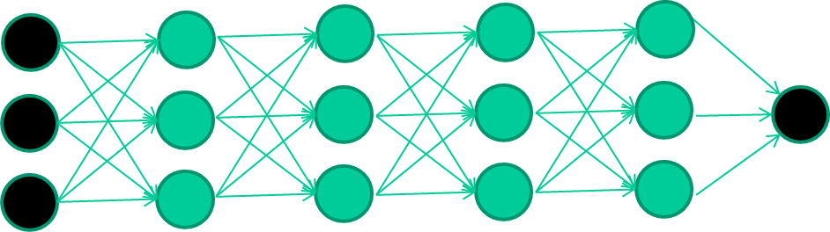
3. multilayer neural networks have been around for
25 years. What’s actually new?
we have always had good algorithms for learning the
weights in networks with 1 hidden layer
but these algorithms are not good at learning the weights for
networks with more hidden layers
what’s new is: algorithms for training many-later networks

Slide 9
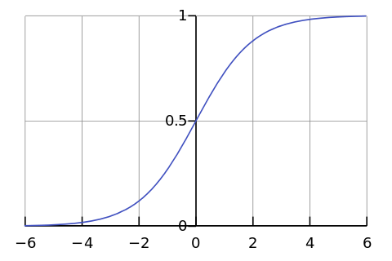

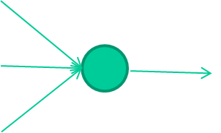
-0.06
W1
W2
f(x)
-2.5
W3
1.4

Slide 10
-0.06
2.7
-8.6
f(x)
-2.5
0.002
x = -0.06×2.7 + 2.5×8.6 + 1.4×0.002 = 21.34
1.4

Slide 11
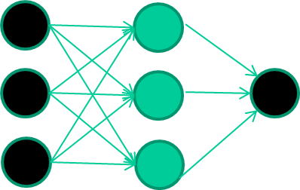
A dataset
Fields class
1.4 2.7 1.9 0
3.8 3.4 3.2 0
6.4 2.8 1.7 1
4.1 0.1 0.2 0
etc …

Slide 12
Training the neural network
Fields class
1.4 2.7 1.9 0
3.8 3.4 3.2 0
6.4 2.8 1.7 1
4.1 0.1 0.2 0
etc …

Slide 13
Training data
Fields class
1.4 2.7 1.9 0
3.8 3.4 3.2 0
6.4 2.8 1.7 1
4.1 0.1 0.2 0
etc …
Initialise with random weights

Slide 14
Training data
Fields class
1.4 2.7 1.9 0
3.8 3.4 3.2 0
6.4 2.8 1.7 1
4.1 0.1 0.2 0
etc …
Present a training pattern
1.4
2.7
1.9

Slide 15
Training data
Fields class
1.4 2.7 1.9 0
3.8 3.4 3.2 0
6.4 2.8 1.7 1
4.1 0.1 0.2 0
etc …
Feed it through to get output
1.4
2.7 0.8
1.9

Slide 16
Training data
Fields class
1.4 2.7 1.9 0
3.8 3.4 3.2 0
6.4 2.8 1.7 1
4.1 0.1 0.2 0
etc …
Compare with target output
1.4
2.7 0.8
0
1.9 error 0.8

Slide 17


Training data
Fields class
1.4 2.7 1.9 0
3.8 3.4 3.2 0
6.4 2.8 1.7 1
4.1 0.1 0.2 0
etc …
Adjust weights based on error
1.4
2.7 0.8
0
1.9 error 0.8

Slide 18
Training data
Fields class
1.4 2.7 1.9 0
3.8 3.4 3.2 0
6.4 2.8 1.7 1
4.1 0.1 0.2 0
etc …
Present a training pattern
6.4
2.8
1.7

Slide 19
Training data
Fields class
1.4 2.7 1.9 0
3.8 3.4 3.2 0
6.4 2.8 1.7 1
4.1 0.1 0.2 0
etc …
Feed it through to get output
6.4
2.8 0.9
1.7

Slide 20
Training data
Fields class
1.4 2.7 1.9 0
3.8 3.4 3.2 0
6.4 2.8 1.7 1
4.1 0.1 0.2 0
etc …
Compare with target output
6.4
2.8 0.9
1
1.7 error -0.1

Slide 21
Training data
Fields class
1.4 2.7 1.9 0
3.8 3.4 3.2 0
6.4 2.8 1.7 1
4.1 0.1 0.2 0
etc …
Adjust weights based on error
6.4
2.8 0.9
1
1.7 error -0.1

Slide 22
Training data
Fields class
1.4 2.7 1.9 0
3.8 3.4 3.2 0
6.4 2.8 1.7 1
4.1 0.1 0.2 0
etc …
And so on ….
6.4
2.8 0.9
1
1.7 error -0.1
Repeat this thousands, maybe millions of times – each time
taking a random training instance, and making slight
weight adjustments
Algorithms for weight adjustment are designed to make
changes that will reduce the error

Slide 23
The decision boundary perspective…
Initial random weights

Slide 24
The decision boundary perspective…
Present a training instance / adjust the weights

Slide 25
The decision boundary perspective…
Present a training instance / adjust the weights

Slide 26
The decision boundary perspective…
Present a training instance / adjust the weights

Slide 27
The decision boundary perspective…
Present a training instance / adjust the weights

Slide 28
The decision boundary perspective…
Eventually ….

Slide 29
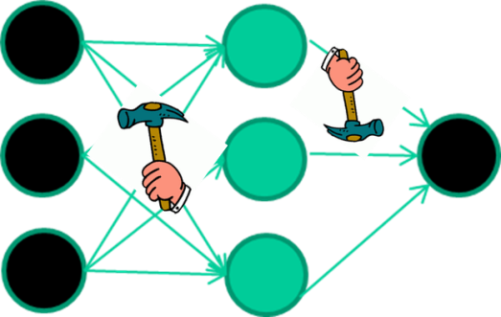
Points to Ponder
weight-learning algorithms for NNs are dumb
they work by making thousands and thousands of tiny adjustments, each making the network do better at the most recent pattern, but perhaps a little worse on many others
but, by dumb luck, eventually this tends to be good enough to
learn effective classifiers for many real applications

Slide 30
Some other points
Detail of a standard NN weight learning algorithm – later
If f(x) is non-linear, a network with 1 hidden layer can, in theory, learn perfectly any classification problem. A set of weights exists that can produce the targets from the inputs. The problem is finding them.

Slide 31
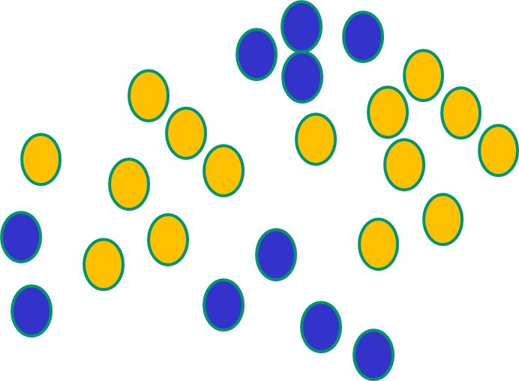
Some other ‘by the way’ points
If f(x) is linear, the NN can only draw straight decision boundaries (even if there are many layers of units)

Slide 32
Some other ‘by the way’ points
NNs use nonlinear f(x) so they
can draw complex boundaries,
but keep the data unchanged

Slide 33
Some other ‘by the way’ points
NNs use nonlinear f(x) so they SVMs only draw straight lines,
can draw complex boundaries, but they transform the data first
but keep the data unchanged in a way that makes that OK

Slide 34
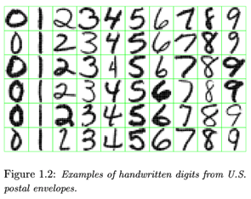
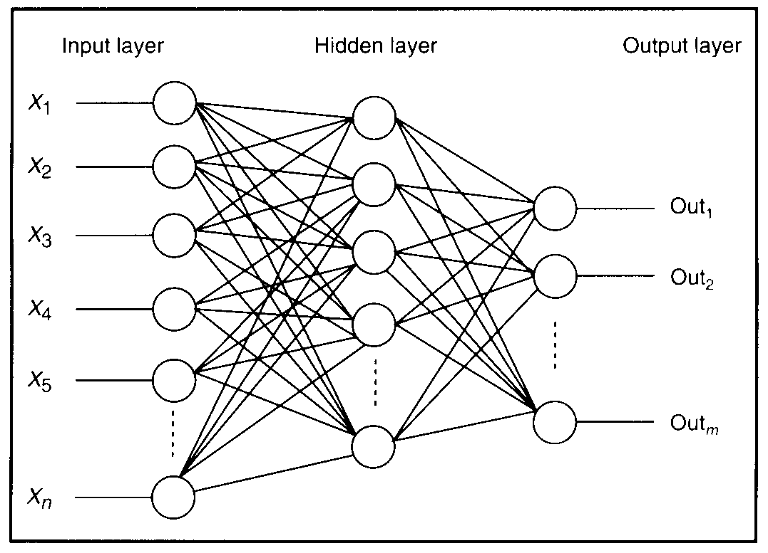

Feature detectors

Slide 35
what is this unit doing?

Slide 36
Hidden layer units become self-organised feature detectors
1 5 10 15 20 25 …
…
1
strong +ve weight
low/zero weight
63

Slide 37
What does this unit detect?
1 5 10 15 20 25 …
…
1
strong +ve weight
low/zero weight
63

Slide 38
What does this unit detect?
1 5 10 15 20 25 …
…
1
strong +ve weight
low/zero weight
it will send strong signal for a horizontal
line in the top row, ignoring everywhere else
63

Slide 39
What does this unit detect?
1 5 10 15 20 25 …
…
1
strong +ve weight
low/zero weight
63

Slide 40
What does this unit detect?
1 5 10 15 20 25 …
…
1
strong +ve weight
low/zero weight
Strong signal for a dark area in the top left
corner
63

Slide 41
What features might you expect a good NN
to learn, when trained with data like this?

Slide 42
vertical lines
1
63

Slide 43
Horizontal lines
1
63

Slide 44
Small circles
1
63

Slide 45
Small circles
1
But what about position invariance ???
our example unit detectors were tied to
specific parts of the image
63

Slide 46
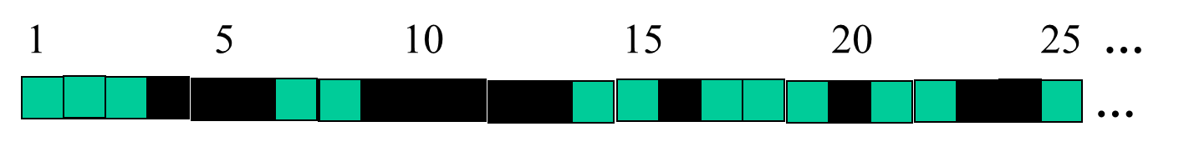
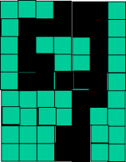
successive layers can learn higher-level features …
detect lines in
Specific positions
etc …
Higher level detetors
( horizontal line,
“RHS vertical lune”
“upper loop”, etc…
etc …
v

Slide 47
successive layers can learn higher-level features …
detect lines in
Specific positions
etc …
Higher level detetors
( horizontal line,
“RHS vertical lune”
“upper loop”, etc…
etc …
v
What does this unit detect?

Slide 48
So: multiple layers make sense

Slide 49
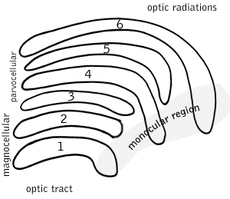
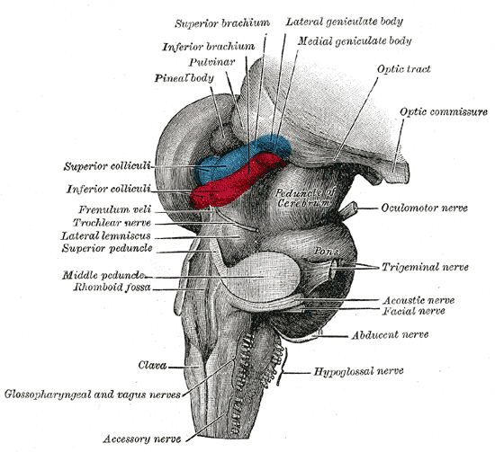
So: multiple layers make sense
Your brain works that way

Slide 50
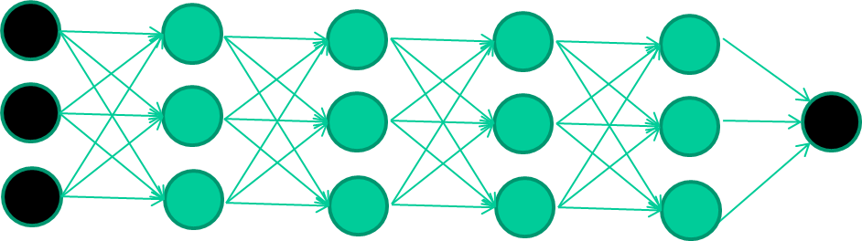
So: multiple layers make sense
Many-layer neural network architectures should be capable of learning the true underlying features and ‘feature logic’, and therefore generalise very well …

Slide 51


But, until very recently, our weight-learning algorithms simply did not work on multi-layer architectures

Slide 52
Along came deep learning …

Slide 53
The new way to train multi-layer NNs…

Slide 54
The new way to train multi-layer NNs…
Train this layer first

Slide 55
The new way to train multi-layer NNs…
Train this layer first
then this layer

Slide 56
The new way to train multi-layer NNs…
Train this layer first
then this layer
then this layer

Slide 57
The new way to train multi-layer NNs…
Train this layer first
then this layer
then this layer
then this layer

Slide 58
The new way to train multi-layer NNs…
Train this layer first
then this layer
then this layer
then this layer
finally this layer

Slide 59
The new way to train multi-layer NNs…
EACH of the (non-output) layers is trained to be an auto-encoder
Basically, it is forced to learn good features that describe what comes from the previous layer

Slide 60
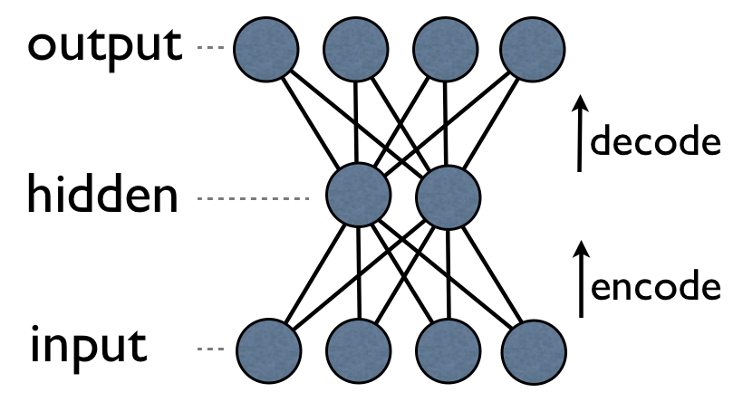
an auto-encoder is trained, with an absolutely standard weight-adjustment algorithm to reproduce the input

Slide 61
an auto-encoder is trained, with an absolutely standard weight-adjustment algorithm to reproduce the input
By making this happen with (many) fewer units than the inputs, this forces the ‘hidden layer’ units to become good feature detectors

Slide 62
intermediate layers are each trained to be auto encoders (or similar)

Slide 63
Final layer trained to predict class based on outputs from previous layers

Slide 64
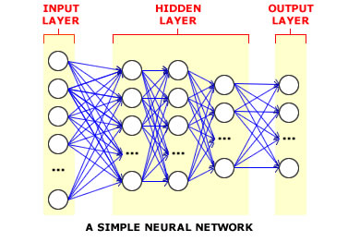
And that’s that
That’s the basic idea
There are many many types of deep learning,
different kinds of autoencoder, variations on architectures and training algorithms, etc…
Very fast growing area …

Slide 65
References
1. David Corne, and Nick Taylor, Heriot-Watt University - dwcorne@gmail.com
These slides and related resources: http://www.macs.hw.ac.uk/~dwcorne/Teaching/dmml.html
2. go here: http://yann.lecun.com/exdb/mnist/
3. From here:
http://people.idsia.ch/~juergen/cvpr2012.pdf

